Slide 1
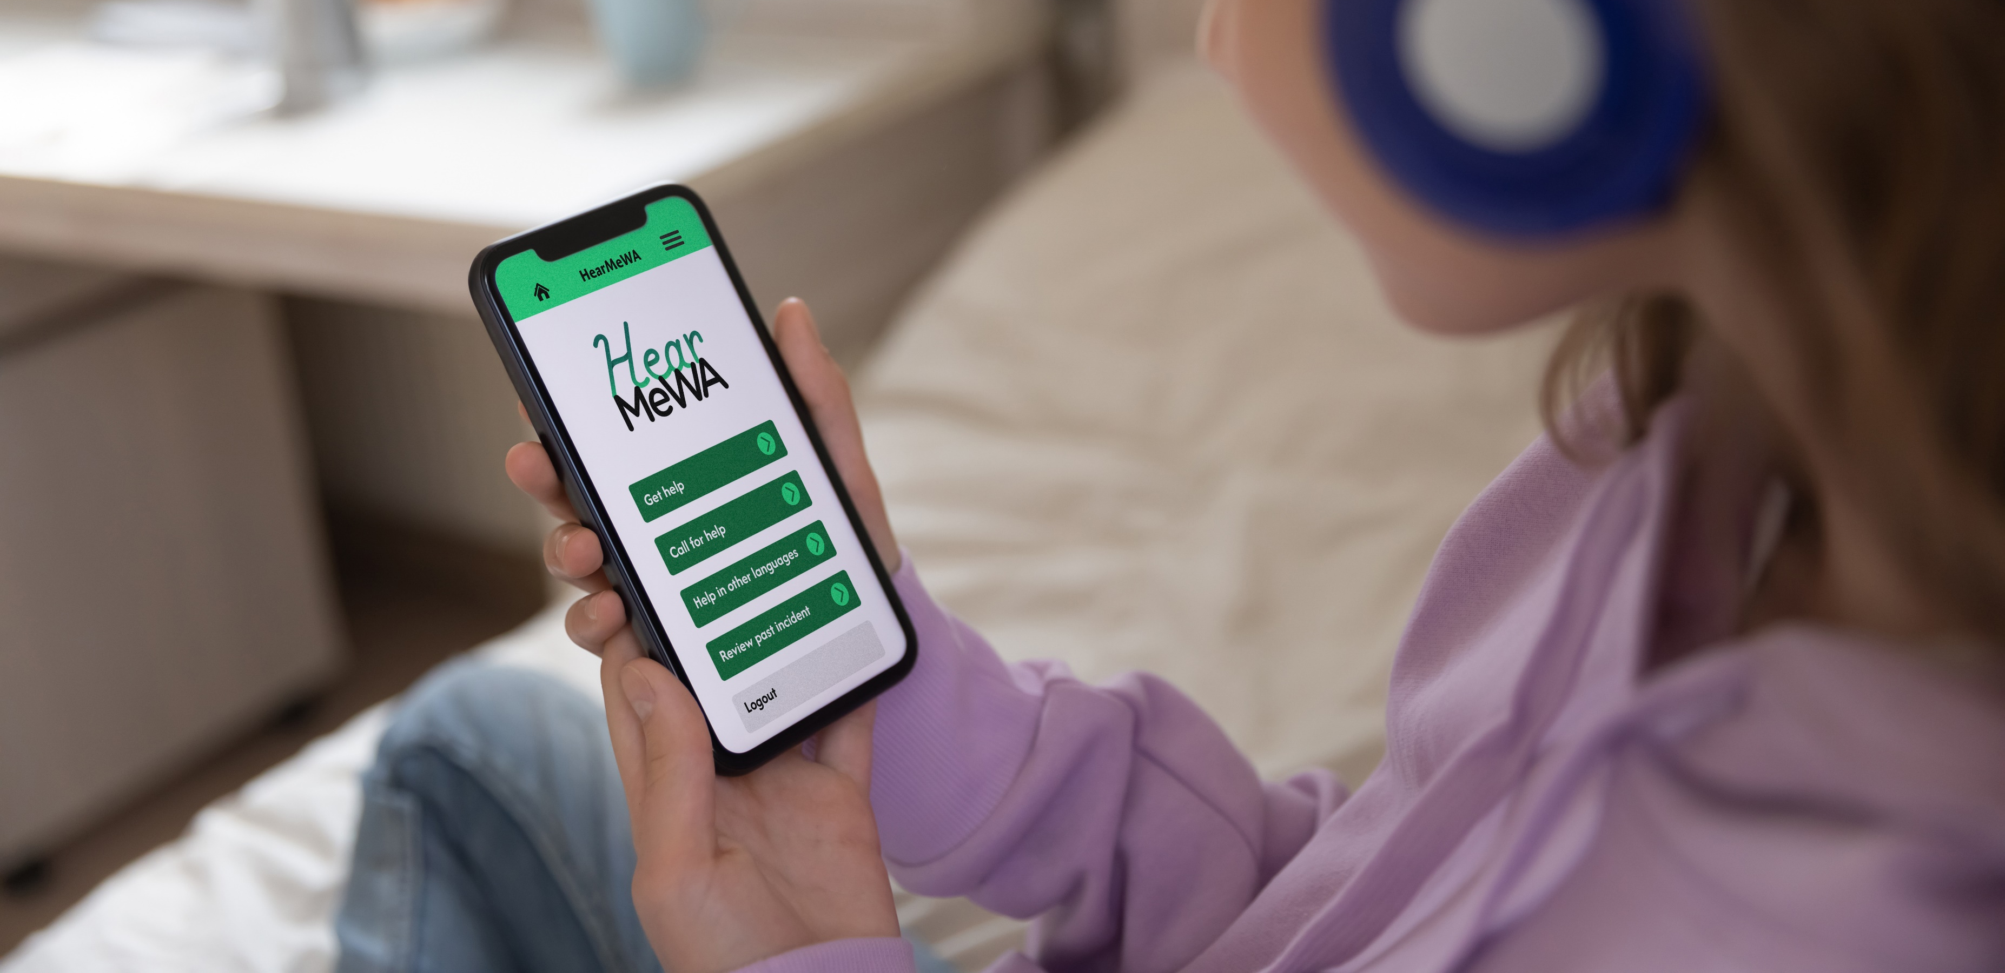
Free, 24/7 Support for Washington Youth

Slide 2
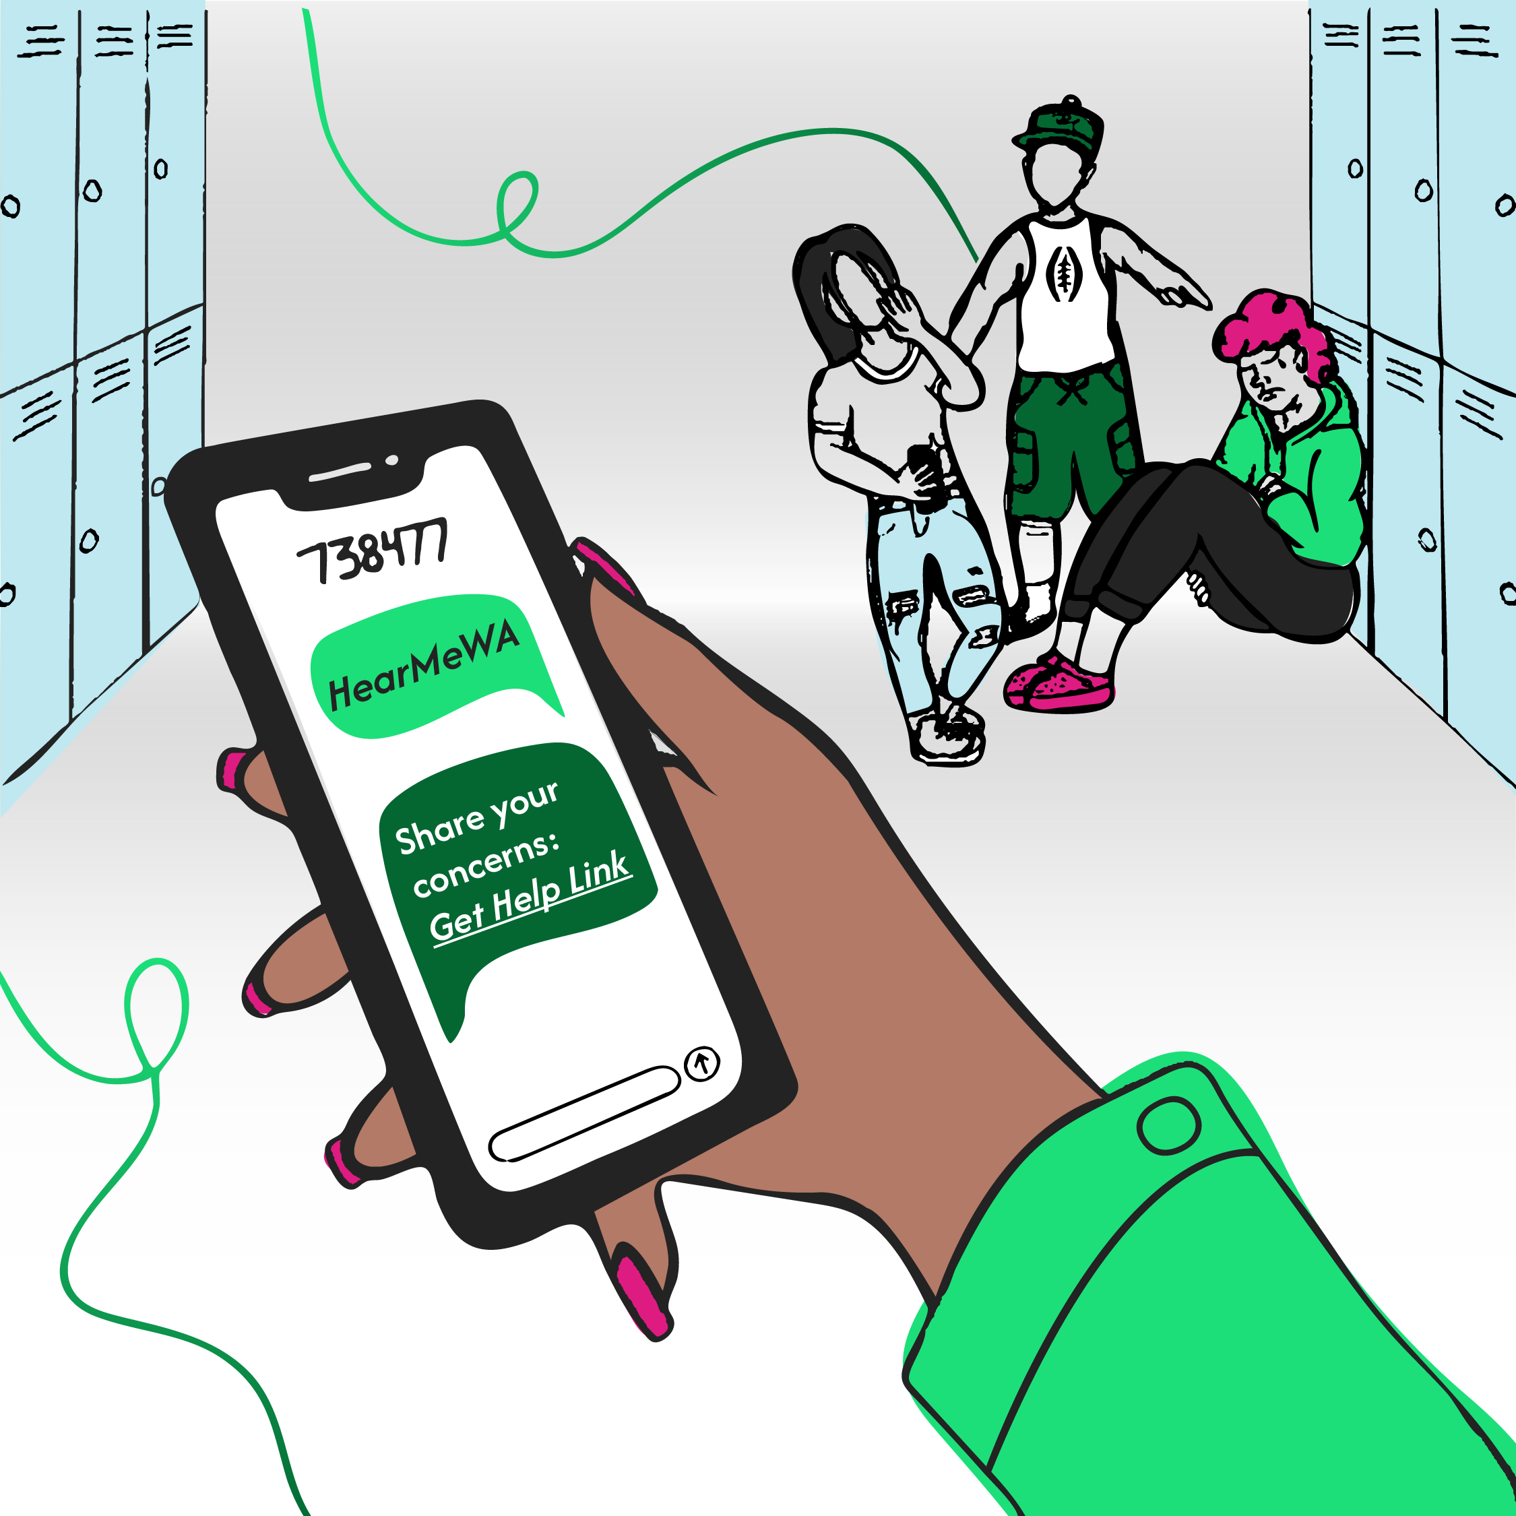
What is HearMeWA?
A 24/7 helpline for Washington youth, connecting them to support for mental health, bullying, anxiety, and more.​
Accessible many ways, whether via phone, text, online, or the HearMeWA app.​
Anonymity for those who seek it. Youth can reach out without sharing personal details, offering a safe space to open up.

Slide 3
For Youth, By Youth
Supporting Youth up to age 25 with issues of any size, from bullying, to mental health issues, to rumors of violence. ​
Youth-Centered: HearMeWA was created with input from young people across Washington, ensuring it meets their needs.​
Guided by Youth: Working with the WA State Attorney General’s Office, the HearMeWA Youth Advisory Group helps shape the program’s values, prioritizing trauma-informed and antiracist efforts.​

Slide 4
Tip Responders
HearMeWA tip responders play an important role in providing safe, supportive services for Washington youth in need. Examples of these partners include:
Educators, such as school administrators, counselors, school nurses, and college and university staff;
Behavioral health professionals;
Child Protective Services (CPS) staff;
Law enforcement officials; and
Emergency services.

Slide 5
Made Possible by the Sandy Hook Promise Crisis Center​
HearMeWA is powered by the Sandy Hook Promise Crisis Center (SHPCC) which receives and responds to every report.​
SHPCC is experienced in saving lives through similar programs across the U.S.​
SHPCC's highly-trained, counselors serves 3.5 million youth and provides 24/7 support. ​

